Slide 1
Movie Matcher
Andrew Russell, Sean Passmore,
Sean Northcutt, Caleb Pierce

Slide 2
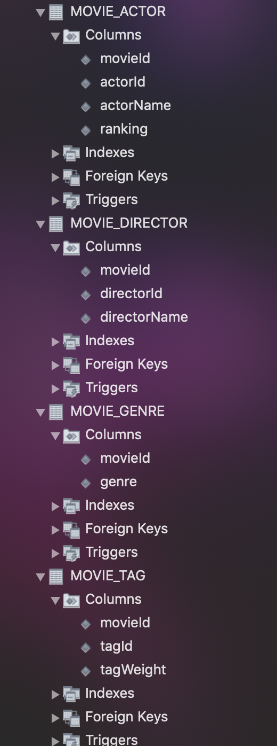
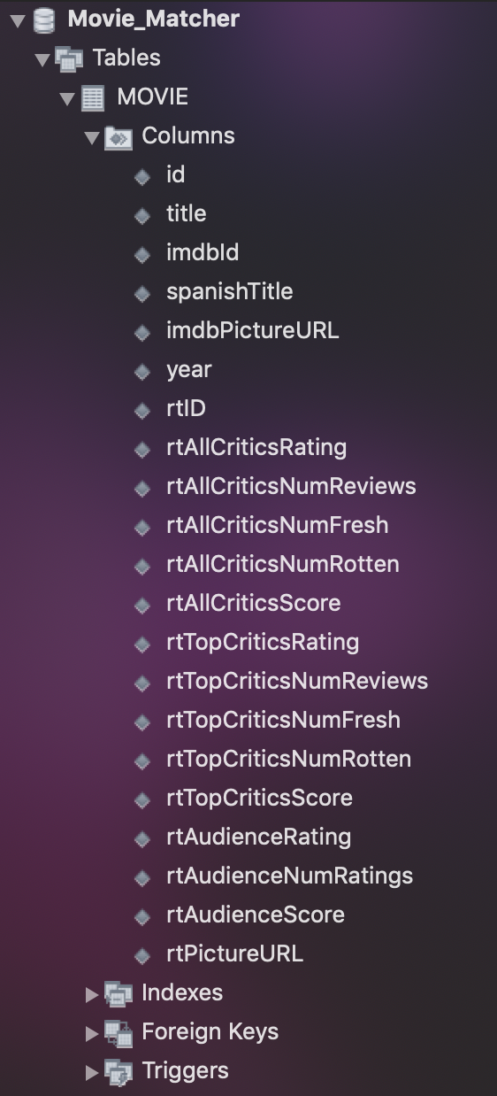
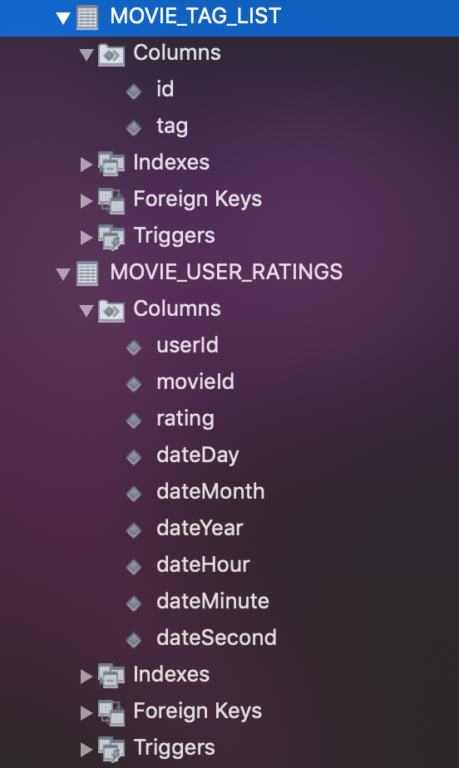
Schema

Slide 3
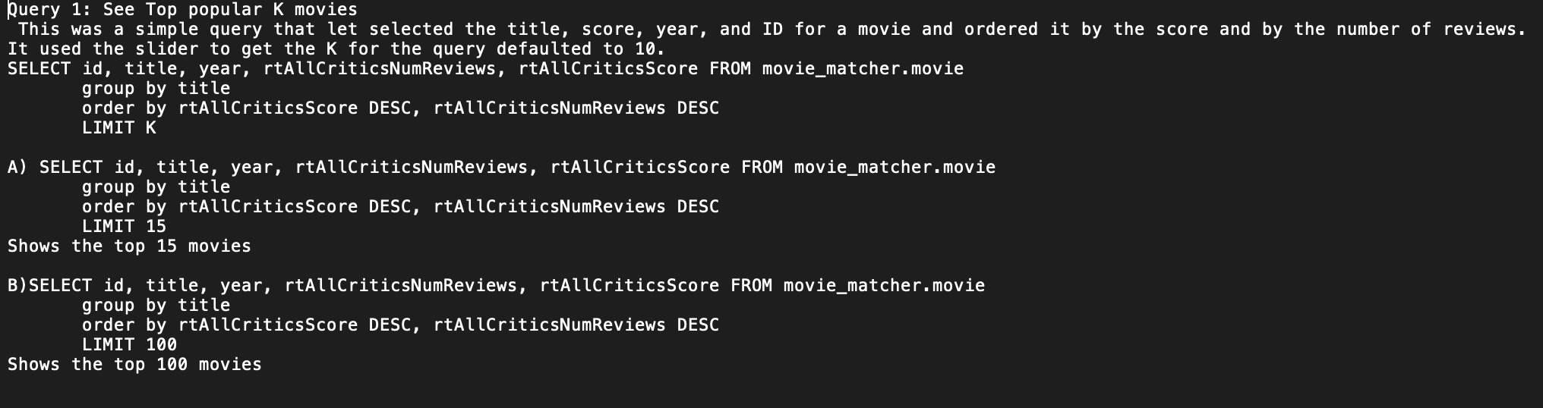

Slide 4
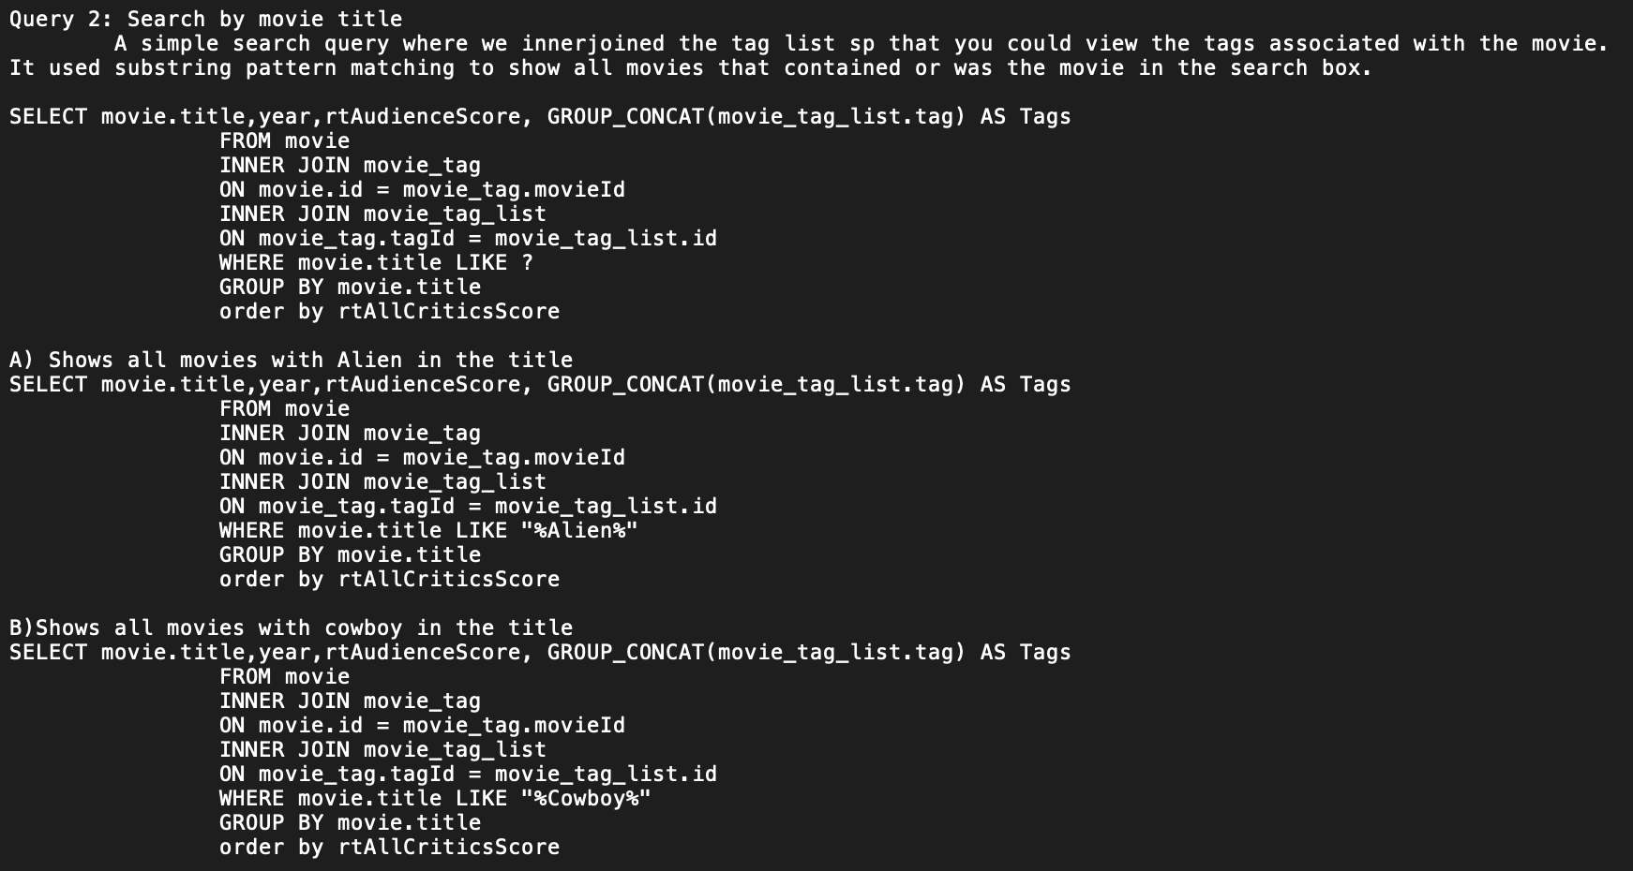

Slide 5
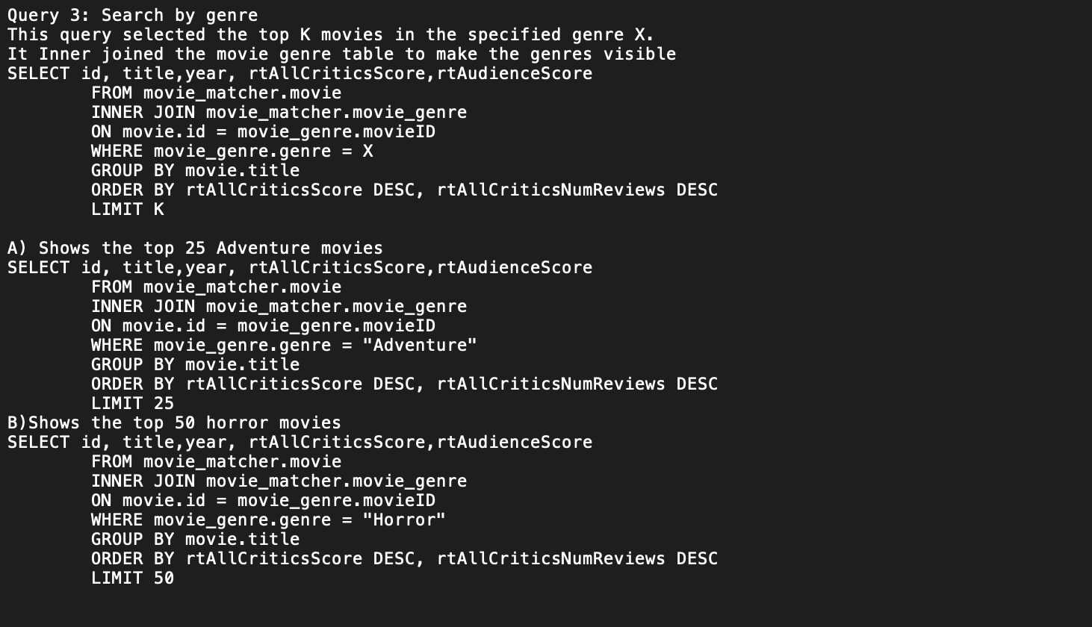

Slide 6
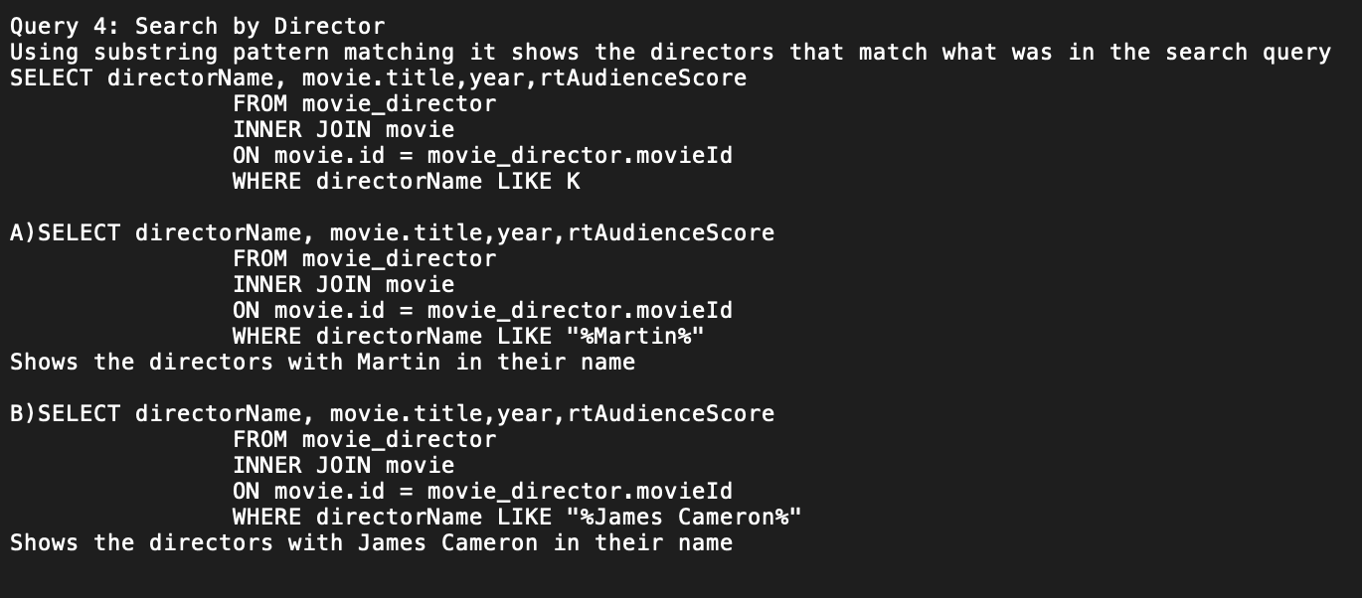

Slide 7
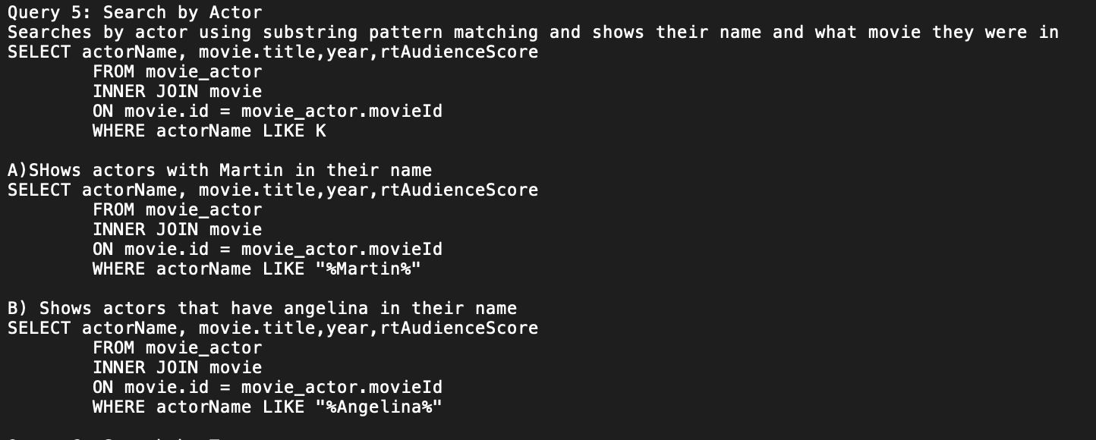

Slide 8
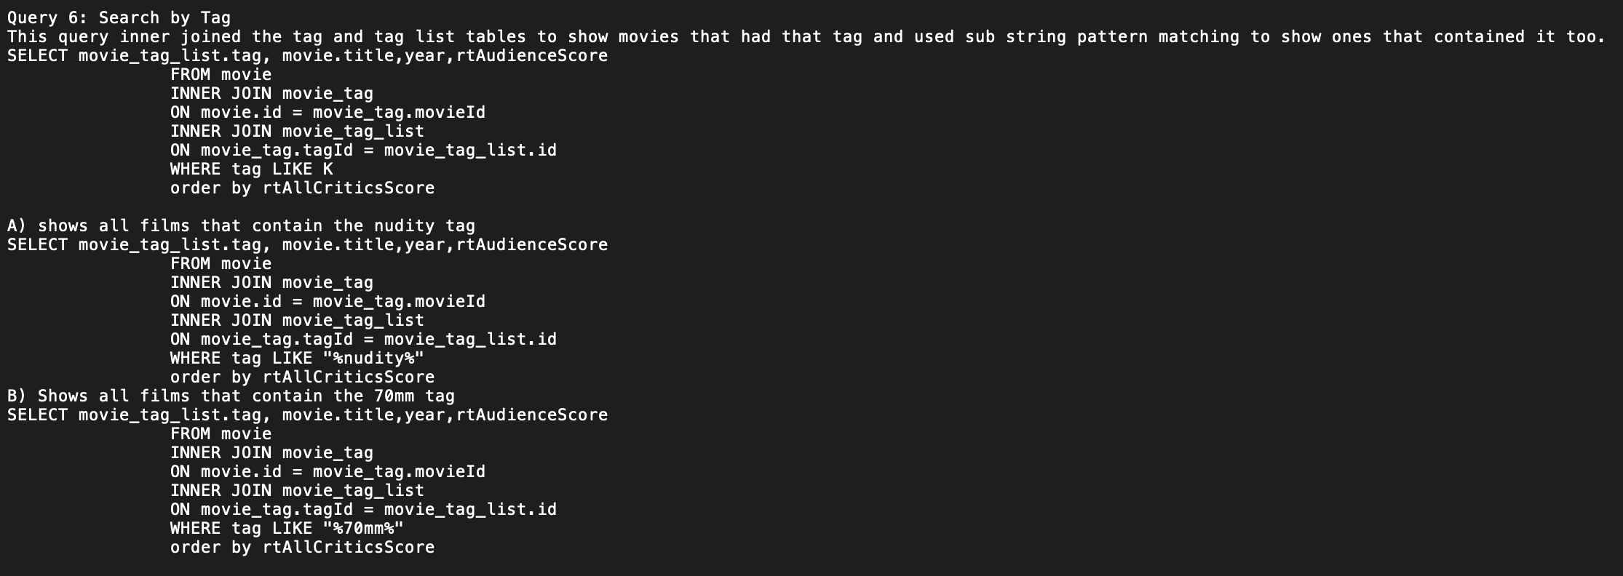

Slide 9
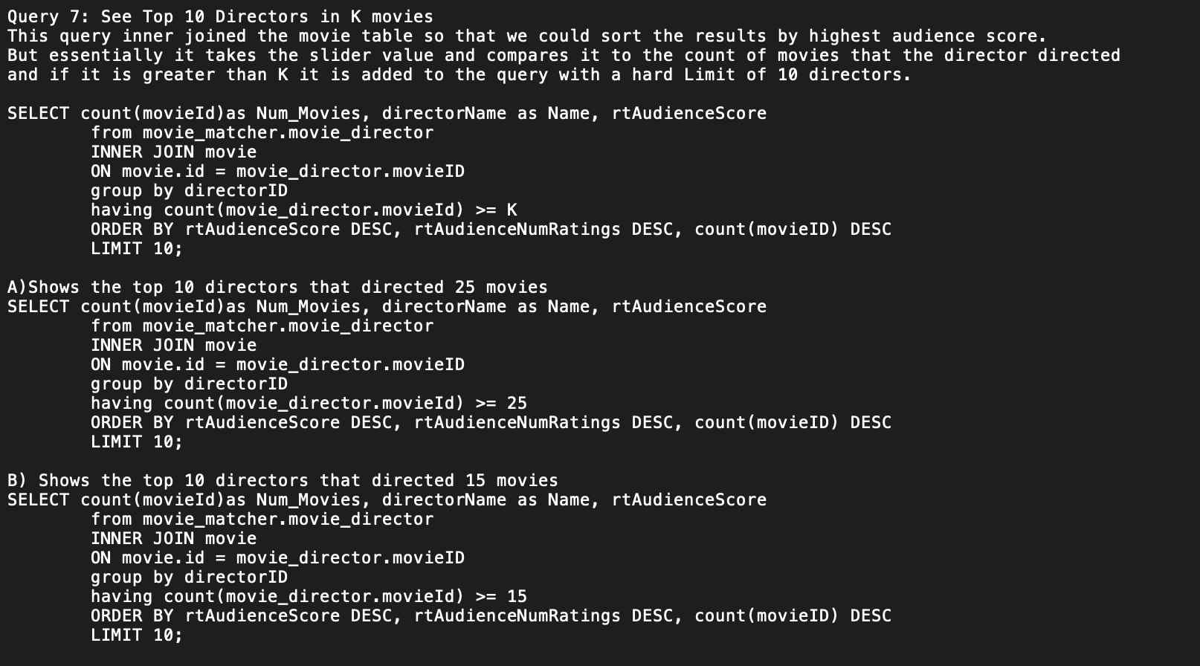

Slide 10
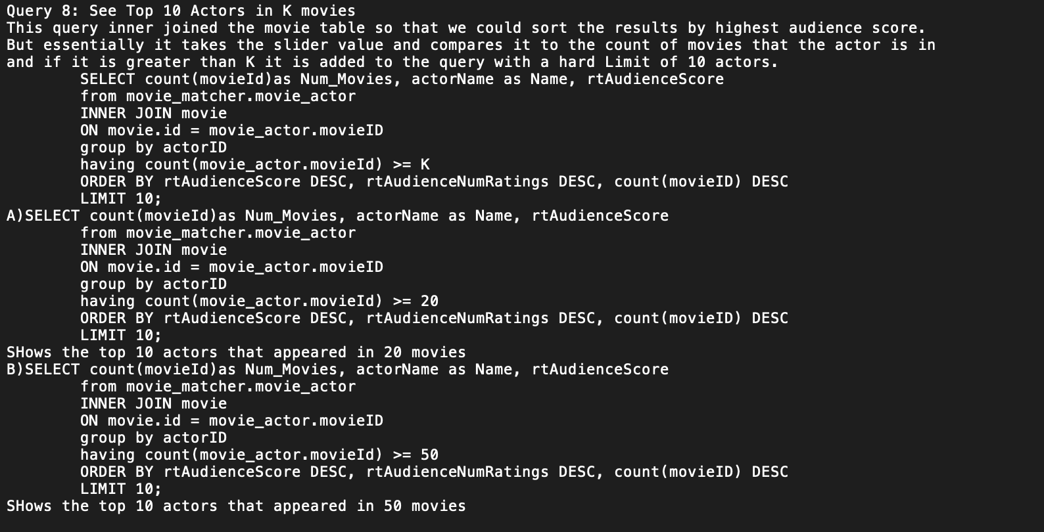

Slide 11
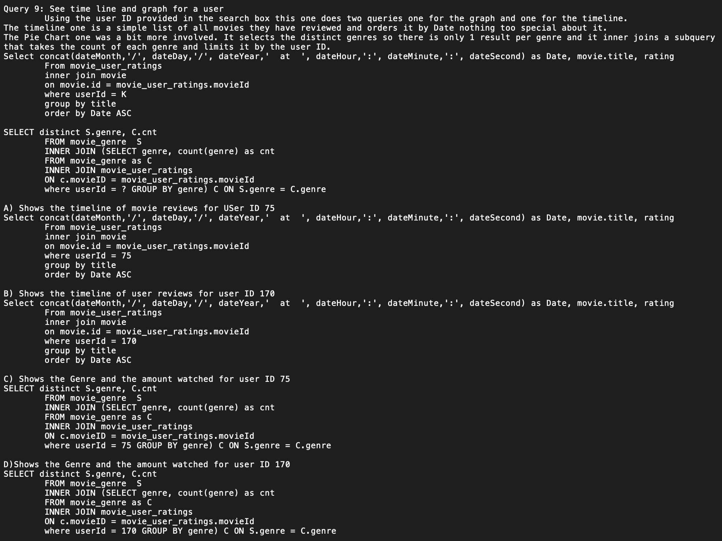

Slide 12
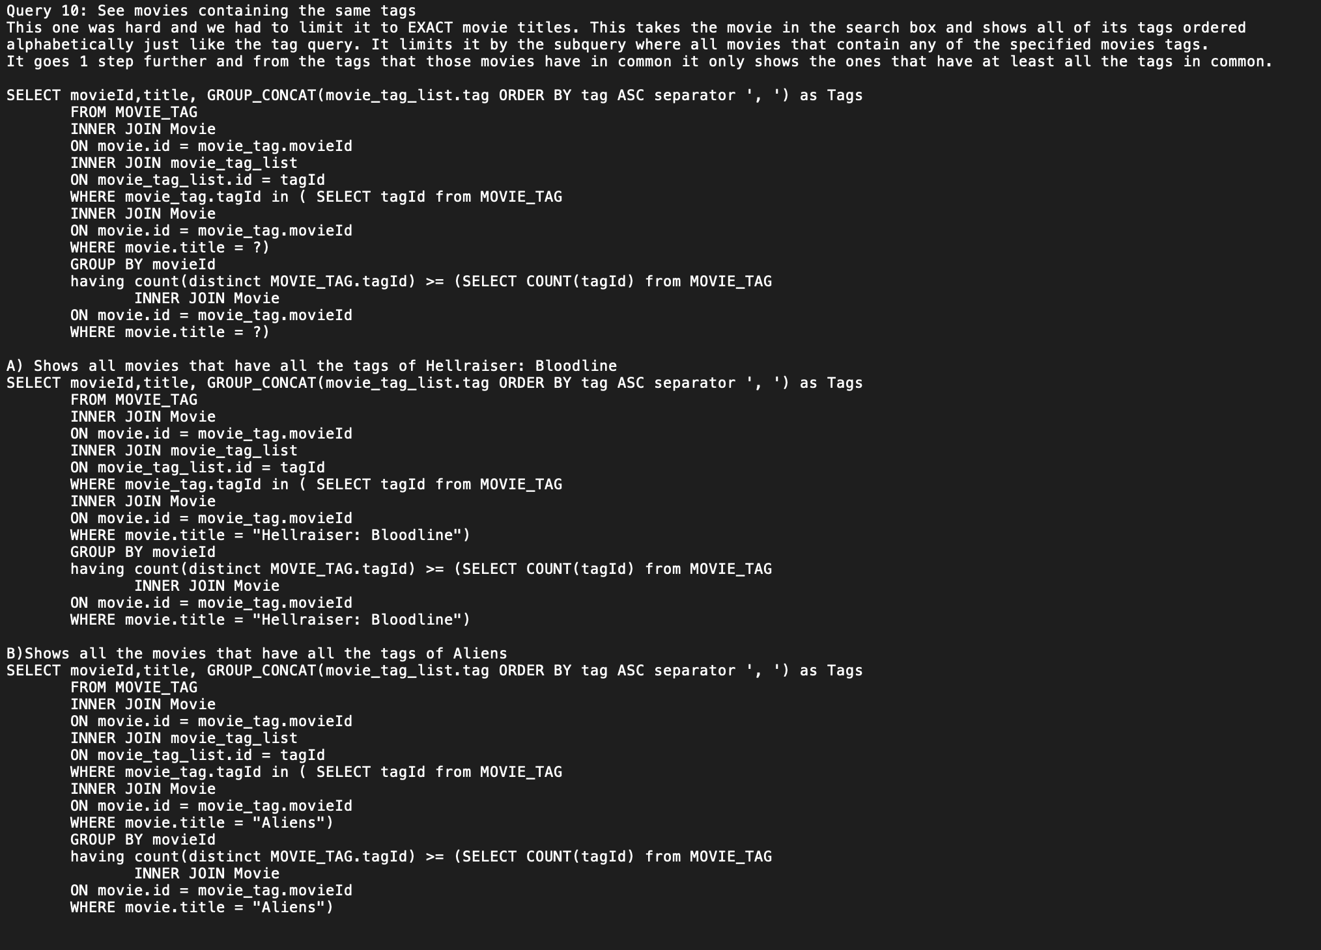

Slide 13
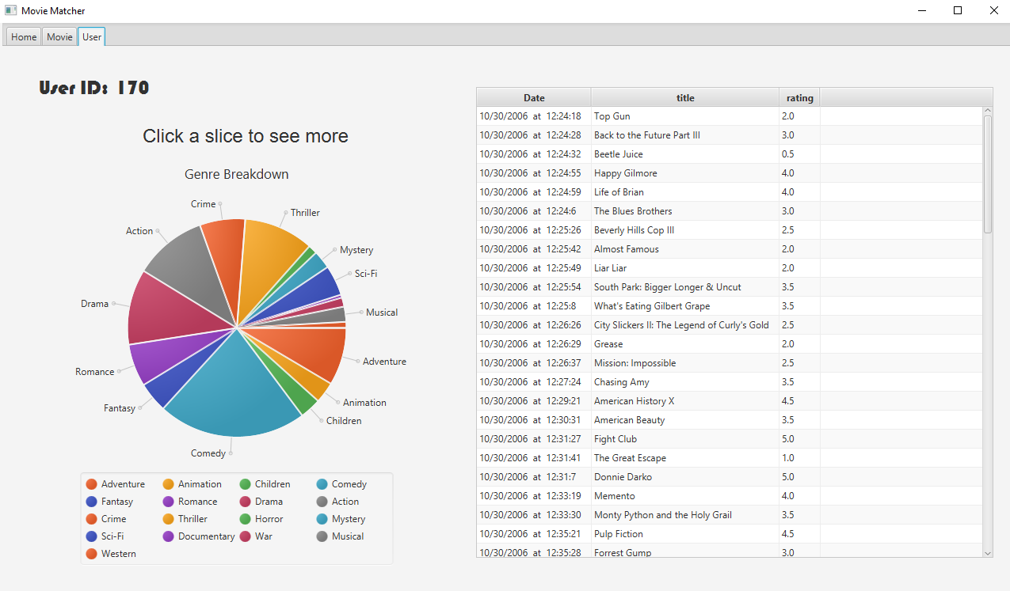
GUI

Slide 14
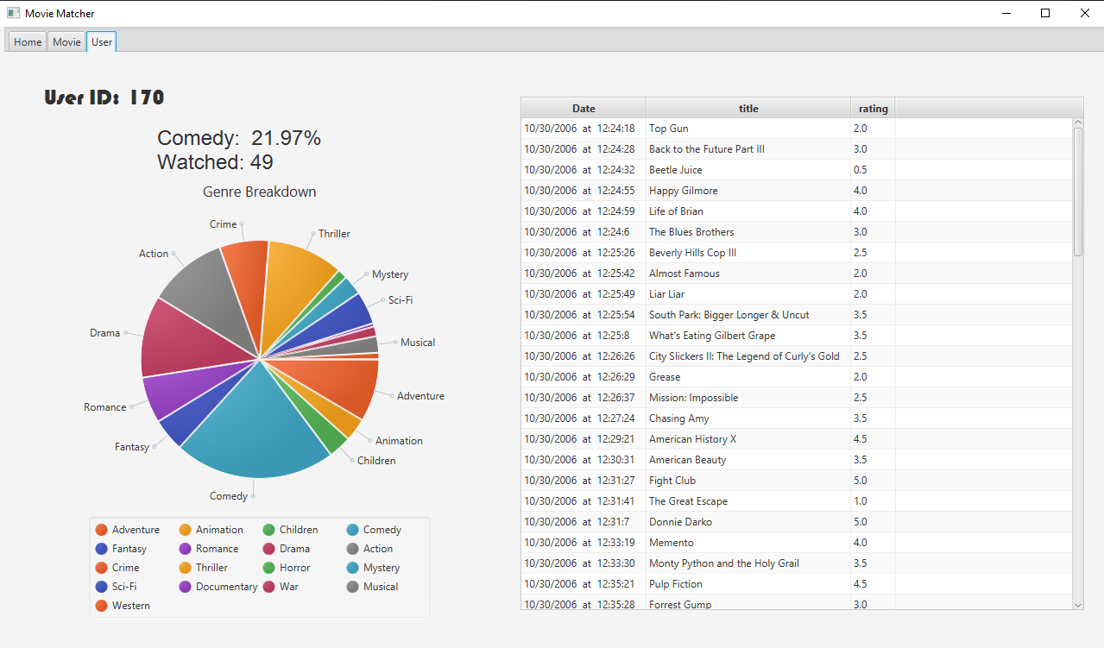

Slide 15
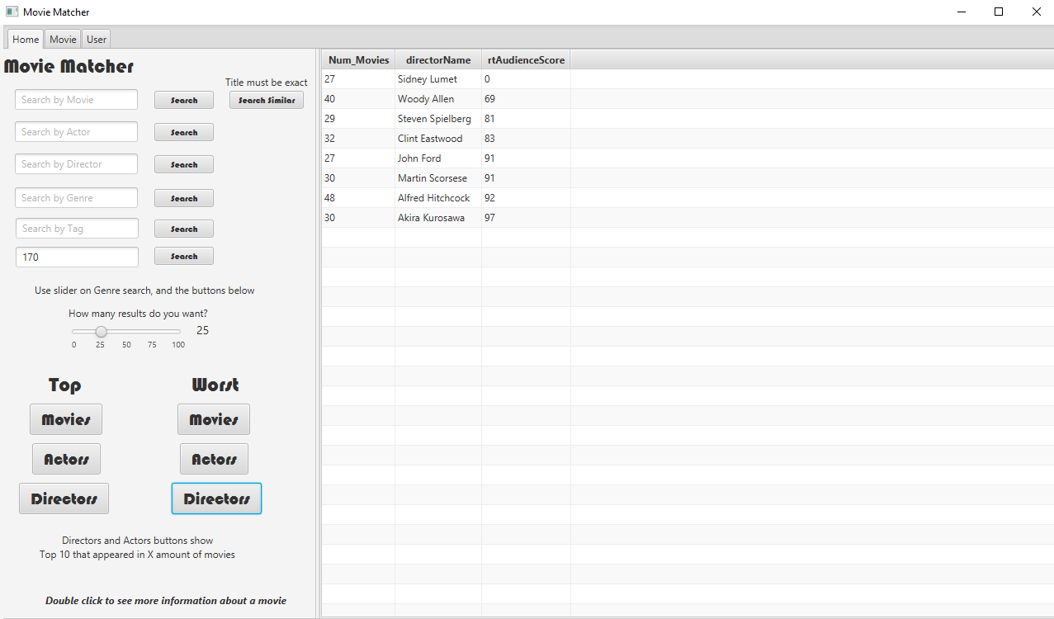

Slide 16
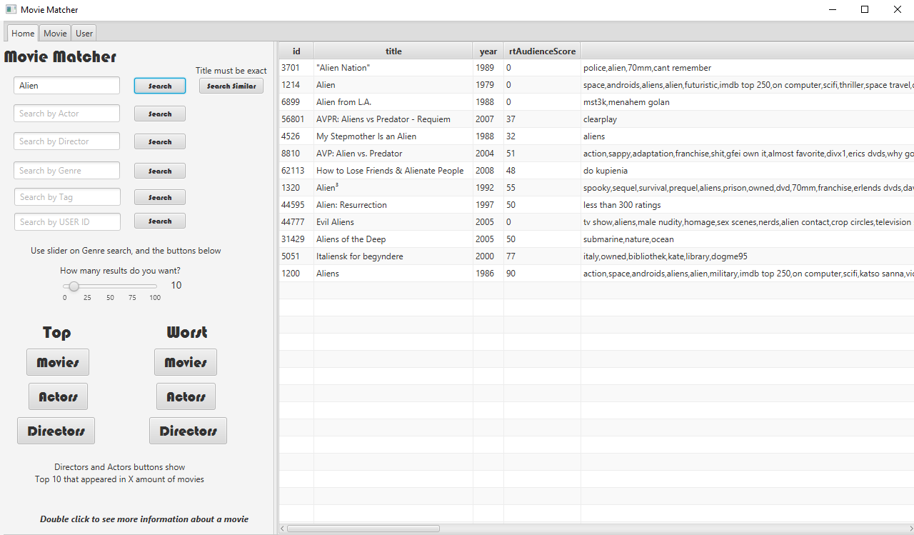

Slide 17
Workload
Andrew Russell - Responsible for the GUI and SQL Statement 9
Sean Passmore - Responsible for Big Data import/processing and SQL Statement 10
Sean Northcutt - Responsible for statements 1 - 4
Caleb Pierce - Responsible for statements 5 - 8

Slide 18
Learning Outcome
We all learned a great deal about manipulating and querying data with SQL during this project. It was much easier to jump right in and have things come together in a project rather than small demonstrations.
We also all learned more about Git and Github together as well as learning how to be a contributing member of a remote team.

